Slide 1
GRAPHS
Dept Of I&CT

Slide 2
Definitions
A graph, G=(V, E), consists of two sets:
  a finite set of vertices(V), and
  a finite, possibly empty set of edges(E)
  V(G) and E(G) represent the sets of vertices and edges of G, respectively
Undirected graph
  The pairs of vertices representing any edge is unordered
  e.g., (v₀, v₁) and (v₁, v₀) represent the same edge
Directed graph
  Each edge as a directed pair of vertices
  e.g. <v₀, v₁> represents an edge, v₀ is the tail and v₁ is the head
(v0, v1) = (v1,v0)
<v0, v1> != <v1,v0>
Dept Of I&CT

Slide 3
Examples for Graph
0
0
0
1
2
1
2
1
3
3
4
5
6
G1
2
G2
complete graph
incomplete graph
G3
V(G1)={0,1,2,3} E(G1)={(0,1),(0,2),(0,3),(1,2),(1,3),(2,3)}
V(G2)={0,1,2,3,4,5,6} E(G2)={(0,1),(0,2),(1,3),(1,4),(2,5),(2,6)}
V(G3)={0,1,2} E(G3)={<0,1>,<1,0>,<1,2>}
complete undirected graph: n(n-1)/2 edges
complete directed graph: n(n-1) edges
Dept Of I&CT

Slide 4
Complete Graph
A complete graph is a graph that has the
maximum number of edges
  for undirected graph with n vertices, the maximum number of edges is n(n-1)/2
  for directed graph with n vertices, the maximum
  number of edges is n(n-1)
  example: G1 (previous slide) is a complete graph
Dept Of I&CT

Slide 5
Adjacent and Incident
If (v0, v1) is an edge in an undirected graph,
  v0 and v1 are adjacent
  The edge (v0, v1) is incident on vertices v0 and v1
If <v0, v1> is an edge in a directed graph
  v0 is adjacent to v1, and v1 is adjacent from v0
  The edge <v0, v1> is incident on v0 and v1
Dept Of I&CT

Slide 6
*Figure 6.3:Example of a graph with feedback loops and a
multigraph (p.260)
0
0
2
1
3
1
2
self edge
multigraph:
multiple occurrences
of the same edge
(a)
(b)
Dept Of I&CT

Slide 7
Subgraph and Path
A subgraph of G is a graph G’ such that V(G’)
is a subset of V(G) and E(G’) is a subset of E(G)
A path from vertex v_{p} to vertex v_{q} in a graph G,
is a sequence of vertices, v_{p}, v_{i1}, v_{i2}, ..., v_{in}, v_{q},
such that (v_{p}, v_{i1}), (v_{i1}, v_{i2}), ..., (v_{in}, v_{q}) are edges in an undirected graph
The length of a path is the number of edges on it
Dept Of I&CT

Slide 8
Figure 6.4: subgraphs of G₁ and G₃ (p.261)
0
0
0
1
2
0
1
2
1
2
3
1
2
3
3
G1
(i) (ii) (iii) (iv)
(a) Some of the subgraph of G₁
0
0
0
0
0
1
1
1
1
2
2
2
(i) (ii) (iii) (iv)
(b) Some of the subgraph of G₃
G3
Dept Of I&CT

Slide 9
Simple Path and Style
A simple path is a path in which all vertices,
except possibly the first and the last, are distinct
A cycle is a simple path in which the first and
the last vertices are the same
In an undirected graph G, two vertices, v₀ and v₁, are connected if there is a path in G from v₀ to v₁
An undirected graph is connected if, for every
pair of distinct vertices v_{i}, vj, there is a path
from vi to v_{j}
Dept Of I&CT

Slide 10
connected
0
0
1
2
1
2
3
3
4
5
6
G1
G2
tree (acyclic graph)
Dept Of I&CT

Slide 11
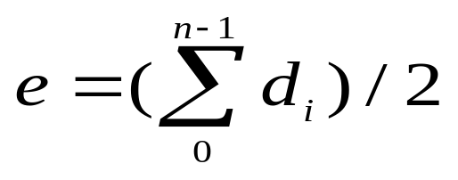
Degree
The degree of a vertex is the number of edges incident to that vertex
For directed graph,
  the in-degree of a vertex v is the number of edges
  that have v as the head
  the out-degree of a vertex v is the number of edges
  that have v as the tail
  if d_{i} is the degree of a vertex i in a graph G with n vertices and e edges, the number of edges is
Dept Of I&CT

Slide 12
undirected graph
degree
3
0
0
2
1
2
3
1
2
3
3
3
3
4
5
6
3
3
1
1
1
1
G1
G2
Dept Of I&CT

Slide 13
0
in:1, out: 1
directed graph
in-degree
out-degree
1
in: 1, out: 2
2
in: 1, out: 0
G3
Dept Of I&CT

Slide 14
Graph representations
0
1
2
Adjacency matrices
Adjacency lists
3
G1
0
1
0
4
2
2
1
5
6
G3
3
7
G4
Dept Of I&CT

Slide 15
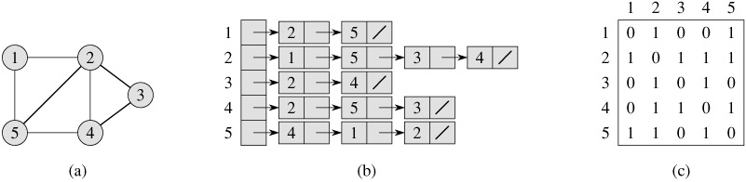
Graph representation – undirected
graph
Adjacency list
Adjacency matrix
Dept Of I&CT

Slide 16
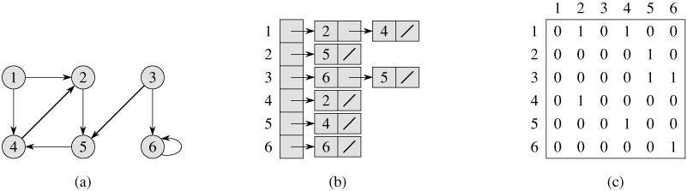
Graph representation – directed
graph
Adjacency list
Adjacency matrix
Dept Of I&CT

Slide 17
Adjacency Matrix
Let G=(V,E) be a graph with n vertices.
The adjacency matrix of G is a two-dimensional
n by n array, say adj_mat
If the edge (vi, vj) is in E(G), adj_mat[i][j]=1
If there is no such edge in E(G), adj_mat[i][j]=0
The adjacency matrix for an undirected graph is symmetric; the adjacency matrix for a digraph
need not be symmetric
Dept Of I&CT

Slide 18
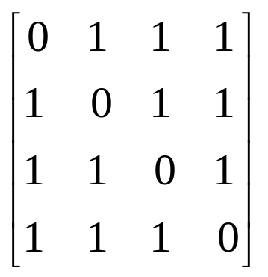
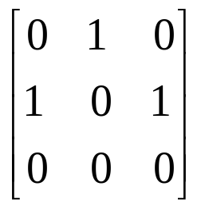
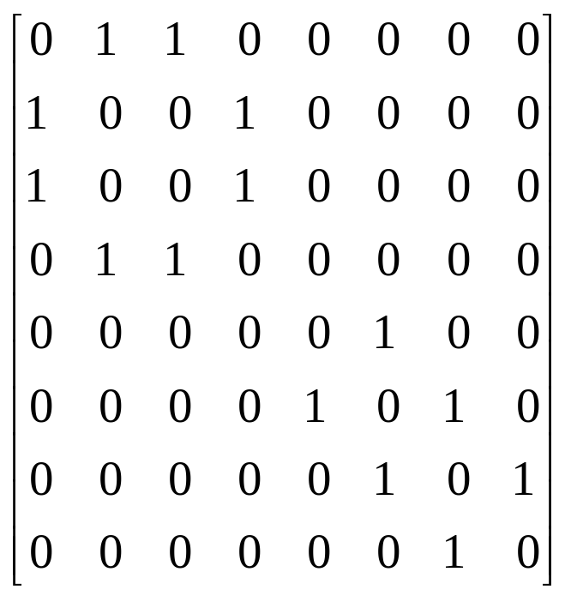
Examples for Adjacency Matrix
0
0
4
0
2
1
5
1
2
3
6
3
1
7
2
G2
G1
symmetric
undirected: n²/2
directed: n²
Dept Of I&CT
G4

Slide 19
Adjacency lists
0
1
1
2
0
2
G3
3
1
2
0
2
3
0
1
2
1
3
0
3
0
1
2
G1
Dept Of I&CT

Slide 20
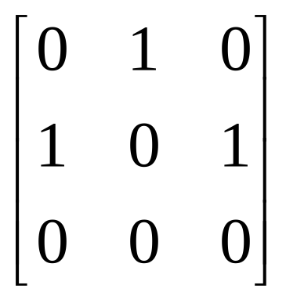
Adjacency lists
0
1
1
2
0
2
G3
Dept Of I&CT

Slide 21
Graph Operations
Traversal
Given G=(V,E) and vertex v, find all w∈V,
such that w connects v.
  Depth First Search (DFS)
  preorder tree traversal
  Breadth First Search (BFS)
  level order tree traversal
Dept Of I&CT

Slide 22
Depth-first search
A depth-first search (DFS) explores a path all the way to a leaf before backtracking and exploring another path
For example, after searching A, then B, then D, the search backtracks and tries another path from B
Node are explored in the order A B D E H L M N I O P C F G J K Q
A
B
C
D
E
F
G
H
I
J
K
L
M
N
O
P
Q
Dept Of I&CT

Slide 23
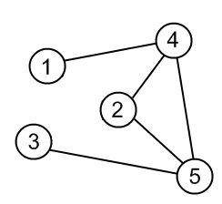
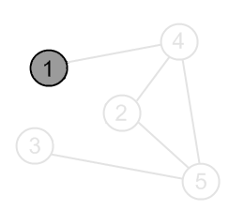
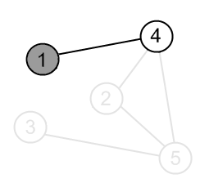
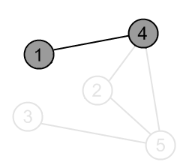
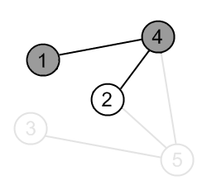
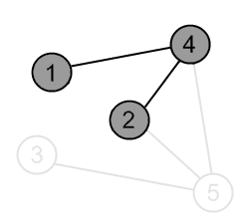
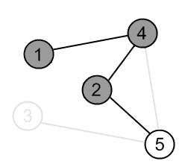
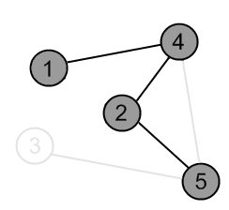
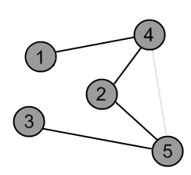
Dept Of I&CT

Slide 24
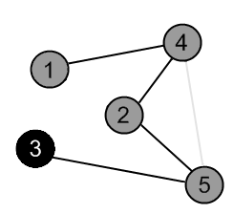
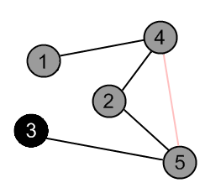
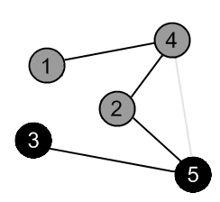
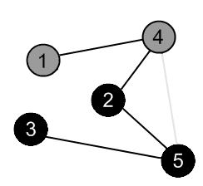
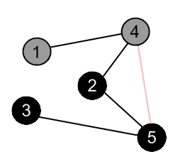
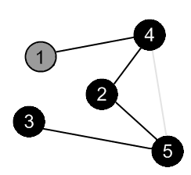
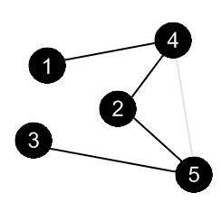
Dept Of I&CT

Slide 25
DFS Algorithm
Mark all the n vertices as not visited.
insert source into stack and mark it visited
while(Stack is not empty)
{
delete Stack element into variable u
place all the adjacent (not visited) vertices of u into Stack and also mark them visited
print u
}
Dept Of I&CT

Slide 26
void dfs(int a[20][20],int n, int source)
{ int visited[10],u,v,i;
for(i=1;i<=n;i++) visited[i]=0;
int S[20],top=-1;
S[++top]=source;
visited[source]=1;
while(top>=0)
{ u=S[top--];
for(v=1;v<=n;v++)
{ if(a[u][v]==1 && visited[v]==0)
{
visited[v]=1; S[++top]=v;
}
}
cout<<u<<" ";
}
Dept Of I&CT

Slide 27
Breadth first search
  It is so named because ---
  It discovers all vertices at distance k from s before discovering vertices at distance k+1.
Dept Of I&CT

Slide 28
Breadth-first search
A breadth-first search (BFS) explores nodes nearest the root before exploring nodes further away
For example, after searching A, then B, then C, the search proceeds with D, E, F, G
Node are explored in the order A B C D E F G H I J K L M N O P Q
A
B
C
D
E
F
G
H
I
J
K
L
M
N
O
P
Q
Dept Of I&CT

Slide 29
Algorithm BFS
Mark all the n vertices as not visited.
insert source into Q and mark it visited
while(Q is not empty)
{
delete Q element into variable u
place all the adjacent (not visited) vertices of u into Q and also
mark them visited
print u
}
Dept Of I&CT

Slide 30
void bfs(int a[20][20],int n,int source)
{
int visited[10],u,v,i;
for(i=1;i<=n;i++) visited[i]=0;
int Q[20],f=-1,r=-1;
Q[++r]=source; visited[source]=1;
while(f<r)
{
u=Q[++f];
for(v=1;v<=n;v++)
{ if(a[u][v]==1 && visited[v]==0)
{
visited[v]=1;
Q[++r]=v;
}
}
cout<<u<<" ";
}
}
Dept Of I&CT

Slide 31
#include<iostream.h>
void bfs(int a[20][20],int n,int source);
void dfs(int a[20][20],int n,int source);
int main()
{
int a[20][20],source, n,i,j;
cout<<"Enter the no of vertices: "; cin>>n;
cout<<"Enter the adjacency matrix: ";
for(i=1;i<=n;i++) for(j=1;j<=n;j++) cin>>a[i][j];
cout<<"Enter the source: ";
cin>>source;
cout<<"\n BFS: "; bfs(a,n,source);
cout<<"\n DFS: "; dfs(a,n,source);
return 1;
}
Dept Of I&CT

Slide 32
Spanning Tree (ST)
A spanning tree is a minimal subgraph G’, such that V(G’)=V(G) and G’ is connected. Spanning Tree is always acyclic.
3
1
2
0
2
3
0
1
2
1
3
0
0
0
3
0
1
2
1
2
1
2
G1
3
3
ST1(G)
ST2(G)
Dept Of I&CT

Slide 33
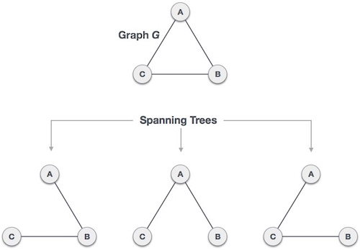
Dept Of I&CT

Slide 34
A connected,
undirected graph
Four of the spanning trees of the graph
Dept Of I&CT

